Slide 1




ecoSolv Products
Distributed by
Fortis Solutions LLC

Slide 2

ecoAgra Growth Enhancement
An amazing breakthrough in agriculture
Created by nature… and perfected by science

Slide 3

Intro
ecoAgra™ is a bio-based noncolloidal plant surfactant formula that can be used on its own, or with fertilizers, pesticides or herbicides.
The nano-scale size of these cleansing molecules allows them to enter the plant cells or the leaves, which causes an accelerated increase in photosynthesis.
This allows the plant to feed better, as well as grow healthier and stronger. Their healthier root systems also produce larger yields.

Slide 4
Photosynthesis is the process by which plants utilize the sunlight to produce sugar. Sugar forms the basis for starches, cellulose, waxes, carbohydrates, oils and proteins that are the building blocks for plant growth. The leaf is full of photosynthesis cells.
When ecoAgra is sprayed on the plant, colloidal Micelles penetrate the pores of the root, stalk and leaf. This results in increased natural photosynthesis.
Purpose

Slide 5

The Benefits
Versatile, and can be used on vegetables, fruits, trees, grass, flowers
Helps plants fight disease and pests
Allows plants to feed better
Promotes strong root systems
Reduces seed germination time

Slide 6
Benefits cont.
Faster seed germination due to better moisture absorption
Improved soil health
Soil nutrients are more efficiently delivered to plants
Better absorption of N, P, K and micro-nutrients results in an INCREASED CROP YIELD - YEARLY
Increases in yield vary from 10 – 15% or more
Water requirements are reduced by up to 20%
Fertilizer/Herbicide requirements are reduced by up to 20%

Slide 7

Additional Benefits
Healthier, bigger and stronger plants
Helps protect plants from freezes
Increased plant growth and crop yields
Increases BRIX levels ( Natural Plant sugar)
Low cost of application, easy to spray

Slide 8
Increased Root Mass – greater access to soil nutrient uptake
Deeper root mass results in less dependency on water
Less dependency on finite resources
Benefits, cont.

Slide 9
Additional Benefits
No EPA or regulatory issues required when spraying
No health hazards to humans and other animals
No concerns of chemical drift or watershed runoff
No special storage or disposal worries

Slide 10
Product Information
Made in the USA
Formulated from extracts of corn, soybeans and other crops grown by American Farmers
Increases the yield of its own ingredients, making it truly sustainable technology

Slide 11
Product Info, cont.
May be mixed with pesticides and herbicides - always follow instructions on label
Self cleans spray equipment
Shown to have positive impact on Goss’ Wilt (field test available)

Slide 12
ecoAgra™ is a readily biodegradable, biobased nano-colloidal plant formula.
When used alone:
No EPA red flags
No warning signs needed when spraying
No concern for chemical drift or run-off
No protective clothing or respirator needed
No health hazards
No special storage needed
Safe for use around people and animals
Safe for the environment
Environmentally Safe

Slide 13
Cost Effectiveness
Low-Cost application per gallon when diluted
One gallon of eA300 makes 300 gallons of ready to use spray
Spray at a rate of 12 gallons of RTU per acre - this requires 5.2 ounces of eA300
Reduction in chemical use has been experienced by some farmers

Slide 14
Current Industries Using ecoAgra
Crop Growers
Nursery’s and Greenhouses
Landscaper’s
Golf Course Operators
Sports Fields
Fruit Grove Owners
Corporate Grounds
… and even homeowners!

Slide 15
Current Countries Using ecoAgra
Australia
Brazil
Canada
Columbia
India
Mexico
Pakistan
South Africa
United Kingdom
United States

Slide 16
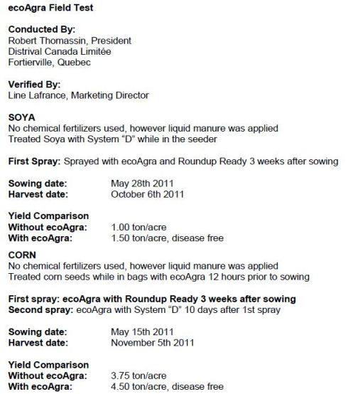
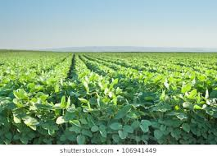

Examples

Slide 17
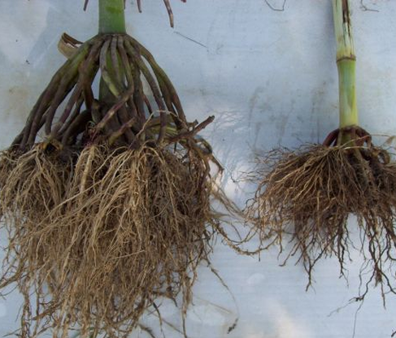
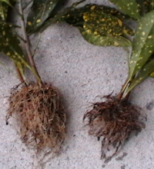
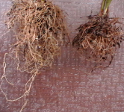
Plant Root Examples
Roots on the left are treated with ecoagra.
Roots on the right are not.

Slide 18
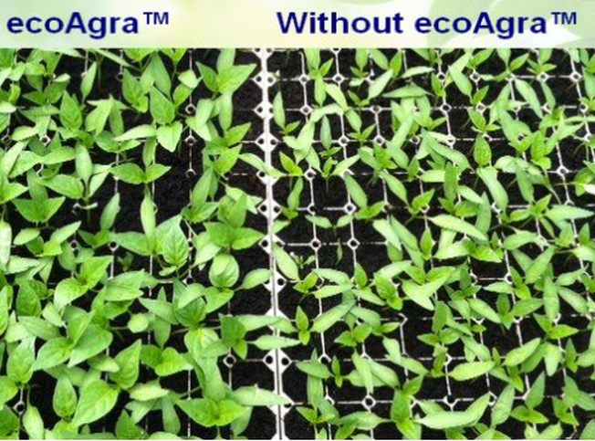
Examples, cont.
These pepper seedlings were planted at the same time. The plants on the left were sprayed once with ecoAgra. The difference is obvious, and will result in sweeter crops, higher yield and less water use.

Slide 19
How to Order
Troy A. Price President Fortis Solutions LLC.
Tprice@fortissolutionllc.com
571-356-0534

